Slide 1
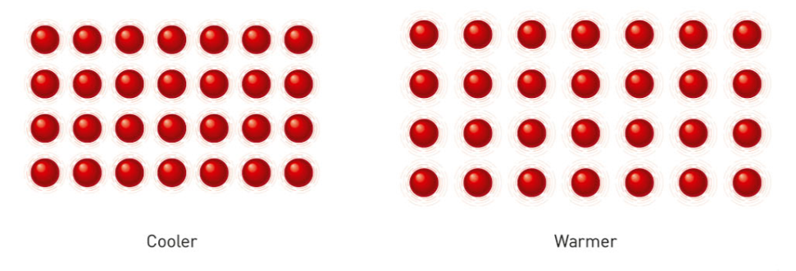
Daily Review
Thermal Energy
When the particles move faster, they collide with more energy and push each other further apart.
The particles in the object take up more space, so the object expands.
Explain why an object expands when it is heated.

Slide 2
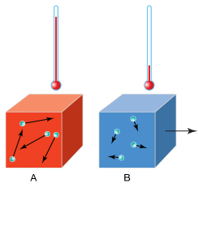
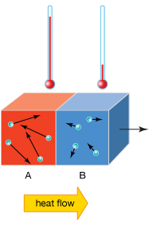
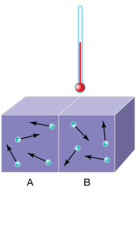
Daily Review
Thermal Equilibrium
Thermal energy will transfer from an object at a higher temperature to one at a lower temperature.
When both objects will reach the same temperature, the transfer of energy stops.
In your own words, describe what is meant by thermal equilibrium.

Slide 3
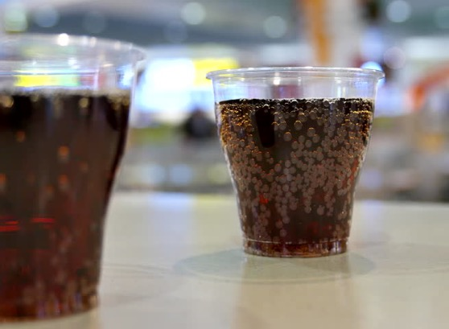
Daily Review
CFU 1
Which object has higher thermal energy?
Describing Heat Transfer
Identify the object with higher thermal energy. State the direction of energy transfer. Describe what will happen to the temperature of the objects.
You leave a glass of coke by the pool while you go for a swim.
CFU 2
Which way will energy be transferred?
The _____ has higher thermal energy and will transfer heat to ____________. The ________ gains heat from the _______ until they are the same temperature.
CFU 3
What will happen to the temperatures of the objects?

Slide 4
Daily Review
CFU 1
Which object has higher thermal energy?
Describing Heat Transfer
Identify the object with higher thermal energy. State the direction of energy transfer. Describe what will happen to the temperature of the objects.
When you get out of the pool, you put some ice cubes in your coke before you drink it.
CFU 2
Which way will energy be transferred?
The _____ has higher thermal energy and will transfer heat to ____________. The ________ gains heat from the _______ until they are the same temperature.
CFU 3
What will happen to the temperatures of the objects?

Slide 5
Temperature vs Thermal Energy

Slide 6
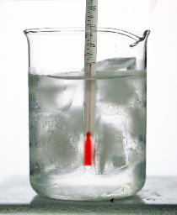
Learning Objectives
CFU
What are we going to learn?
Define temperature.
Explain the difference between temperature and thermal energy.
Compare the amount of thermal energy in objects.
Activate Prior Knowledge
The temperature of an object can be measured using a thermometer.
Think, pair, share: At what temperature does water freeze? At what temperature does water boil?

Slide 7
Concept Development
CFU 1
To a scientist, what is heat?
Temperature
In everyday language, heat and temperature are often used to mean the same thing, but to scientists, they are different.
Thermal energy (heat) is a form of energy and describes the total amount of energy of all particles within an object.
Temperature indicates how hot or cold something is and depends on the average kinetic energy of the particles.
Hotter substances have particles that are moving faster than the particles of cooler substances.
CFU 2
What does temperature measure?
CFU 3
How does the movement of particles differ in hot and cold substances?

Slide 8
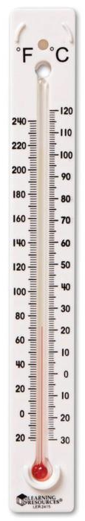
Concept Development
CFU 1
What piece of equipment is used to measure temperature?
Thermometers
Thermometers are used to measure the temperature of a substance.
When we use a thermometer to measure temperature of an object, it is actually measuring its own temperature.
The thermometer is in thermal equilibrium with the object it is measuring.
To get an accurate measurement on a thermometer, you have to allow time for the thermometer to reach thermal equilibrium with the object being measured.
CFU 2
What is a thermometer measuring?
CFU 3
Why do you have to wait before taking a measurement with a thermometer?

Slide 9
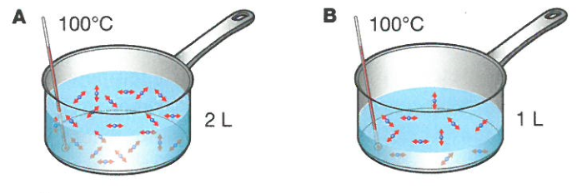
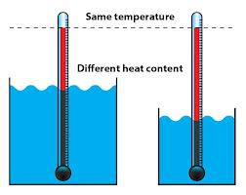
Concept Development
CFU 1
If two objects have the same temperature, what does it say about the kinetic energy of the particles?
Heat vs Temperature: Objects at the same temperature
When two objects are at the same temperature, the average kinetic energy of the particles is the same.
The water in the two saucepans has the same temperature, so the particles have the same average kinetic energy.
The amount of thermal energy in saucepan A is greater than saucepan B because it contains more particles at the same temperature
CFU 2
Why is the thermal energy in saucepan B less than saucepan A?
CFU 3
Which beaker has the least thermal energy? Explain your choice?

Slide 10
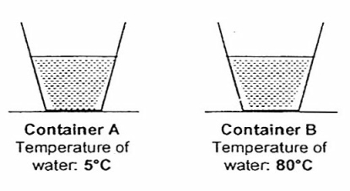
Concept Development
CFU 1
If one object is hotter than the other, what does it say about the kinetic energy of the particles in the objects?
Heat vs Temperature: Objects with the same volume
When two objects are at different temperatures, the average kinetic energy of the particles is higher in one than the other.
If the objects have the same volume, the object with the higher temperature has more thermal energy.
The amount of thermal energy in container A is less than container B because its particles have a lower average kinetic energy.
CFU 2
Why is the thermal energy in container B more than container A?

Slide 11
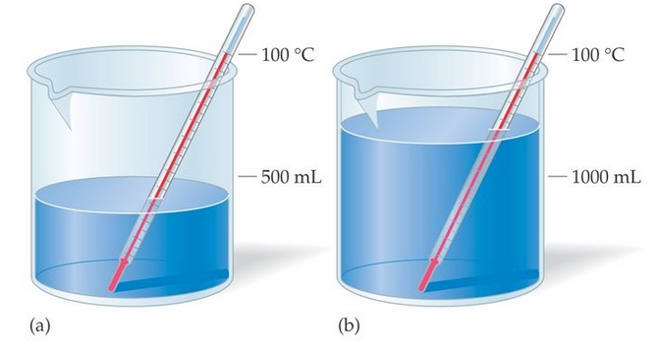
Skill Development/Guided Practice
CFU 1
Is the temperature or the volume the same?
Comparing Thermal Energy
Identify whether the temperature or the volume of the objects is the same. Same temperature = larger object has more thermal energy Same volume = hotter object has more thermal energy Explain why the object has more thermal energy
CFU 2
Which object has more thermal energy? Why?
The beakers of water are the same temperature.
The beaker with 1000mL of water has more thermal energy because it contains more particles at the same temperature.

Slide 12
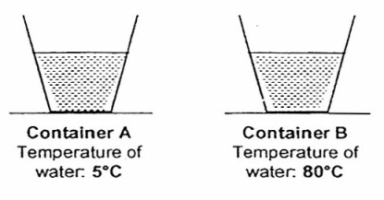
Skill Development/Guided Practice
CFU 1
Is the temperature or the volume the same?
Comparing Thermal Energy
Identify whether the temperature or the volume of the objects is the same. Same temperature = larger object has more thermal energy Same volume = hotter object has more thermal energy Explain why the object has more thermal energy
CFU 2
Which object has more thermal energy? Why?
The beakers of water are the same volume.
The beaker at 80°C has more thermal energy because it contains the same amount of particles, but at a higher temperature.

Slide 13
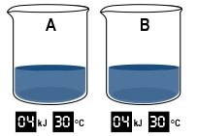
Skill Development/Guided Practice
CFU 1
Is the temperature or the volume the same?
Comparing Thermal Energy
Identify whether the temperature or the volume of the objects is the same. Same temperature = larger object has more thermal energy Same volume = hotter object has more thermal energy Explain why the object has more thermal energy
CFU 2
Which object has more thermal energy? Why?
The beakers of water are the same temperature and same volume.
Both beakers contain the same amount of thermal energy.

Slide 14
Skill Development/Guided Practice
CFU 1
Is the temperature or the volume the same?
Comparing Thermal Energy
Identify whether the temperature or the volume of the objects is the same. Same temperature = larger object has more thermal energy Same volume = hotter object has more thermal energy Explain why the object has more thermal energy
CFU 2
Which object has more thermal energy? Why?
The objects are the same ________. The __________ has more thermal energy because _________________.

Slide 15
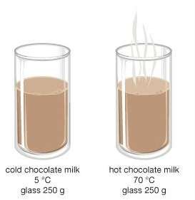
Skill Development/Guided Practice
CFU 1
Is the temperature or the volume the same?
Comparing Thermal Energy
Identify whether the temperature or the volume of the objects is the same. Same temperature = larger object has more thermal energy Same volume = hotter object has more thermal energy Explain why the object has more thermal energy
CFU 2
Which object has more thermal energy? Why?
The objects are the same ________. The __________ has more thermal energy because _________________.

Slide 16
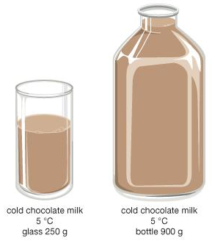
Skill Development/Guided Practice
CFU 1
Is the temperature or the volume the same?
Comparing Thermal Energy
Identify whether the temperature or the volume of the objects is the same. Same temperature = larger object has more thermal energy Same volume = hotter object has more thermal energy Explain why the object has more thermal energy
CFU 2
Which object has more thermal energy? Why?
The objects are the same ________. The __________ has more thermal energy because _________________.

Slide 17
Relevance
Knowing how thermal energy moves from one object to another will help you explain why some objects warm up or cool down, and why hot objects lose heat.
Thermometers use thermal equilibrium to measure the temperature of objects around us.
Understanding the difference between thermal energy and temperature will help you explain why a bucket of cooler water will warm up a cold bath more than a cup full of hot water.

Slide 18
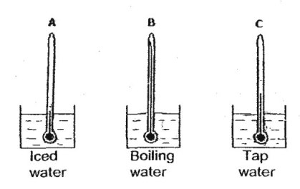
Skill Closure
What is does the temperature of a substance measure?
Skill Closure
How is thermal energy different to temperature?
Skill Closure
Which object has the lowest thermal energy? Explain your choice.

Slide 19
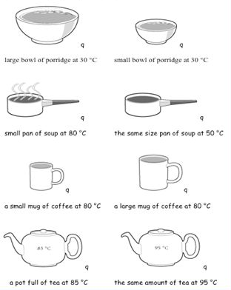
Independent Practice
Complete the questions below on your device or in your book.
What is the difference between thermal energy and temperature?
How does a thermometer measure the temperature of an object?
For each of the pairs of objects on the right, identify the object with the most thermal energy, and explain why it has higher energy.
Then, complete the “Thermal Energy” worksheet on your device or a paper copy.

